Slide 1



HYDRO-GOVERNANCE IN GREECE:
PAST, PRESENT AND FUTURE
Jacques Ganoulis
Former Special Secretary for Water
Emeritus Professor AUTh
Director, UNESCO Chair/INWEB
SWARM: Strengthening Master Curricula in WRM for the Western Balkans
Thessaloniki, 30-31 Oct. 2019

Slide 2






WATER PROBLEMS AND HYDRO-GOVERNANCE
HYDRO-GOVERNANCE
  Political Decision Making
  Consultation
  Social Interaction
  -----------
POLICY
  Water Law
  Water Regulation
  Water Management
  -----------
MAIN ISSUES
  Technical
  Socio-Economic
  Administrative
  Political
  -----------
SCIENCE/UNDERSTANDING
  Analytical Description
  Mathematical Modeling
  ---------------
WATER PROBLEMS
  Global Water Crisis
  Water Scarcity
  Groundwater Pollution
  -----------

Slide 3
GOVERNANCE, POLICY AND MANAGEMENT
Governance:
  A multi-level, integrated political and technical process interacting with the civil sector, NGOs and professional organizations for managing complex societal problems
  (Ganoulis & Fried, 2018)
Management:
  Activities based on assumptions, principles, data & models in order to achieve given targets
Policy:
  Application of rules (legal-regulatory ) in order to resolve particular problems
Ganoulis & Fried, 2018

Slide 4
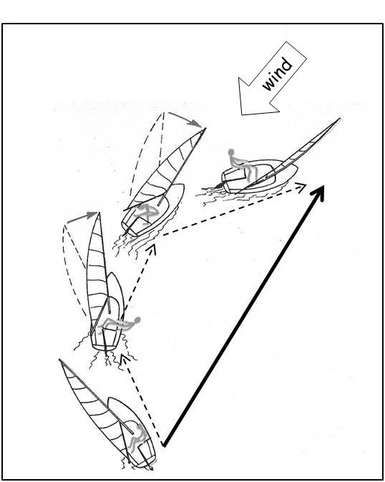
MANAGEMENT, POLICY AND GOVERNANCE
Overall Operational Framework Navigation Rules/Regulation
POLICY
GOVERNANCE
the interactive and
integrated process for achieving a goal against various pressures
(wind, waves, sea currents, ..)
Decision Making at Partcular Step Level:
MANAGEMENT
Ganoulis & Fried, 2018

Slide 5
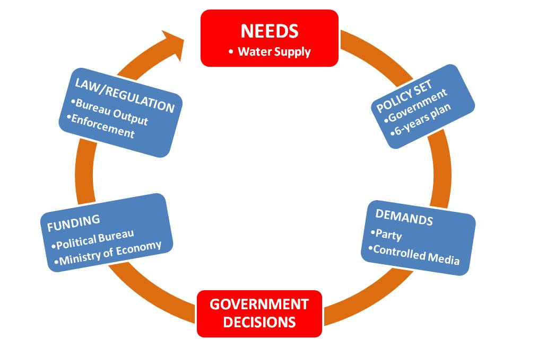
MODELS OF HYDRO-MANAGEMENT (1)
Authoritarian

Slide 6
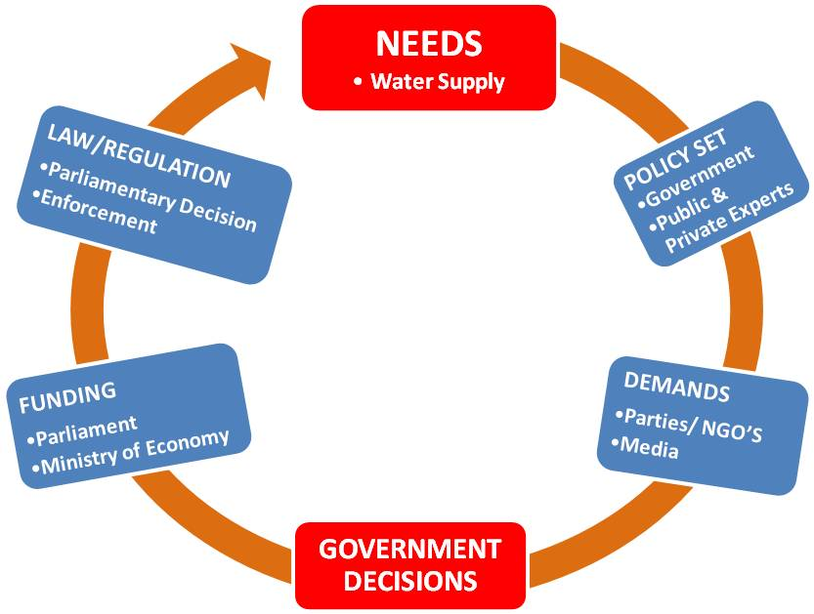
MODELS OF HYDRO-MANAGEMENT (2)
Parlementarian

Slide 7
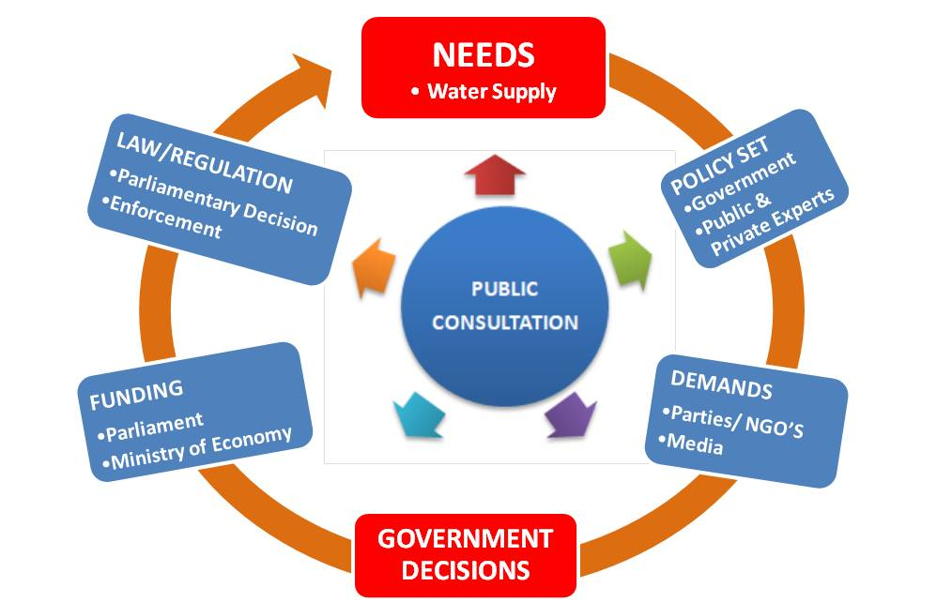
A MODEL OF HYDRO-GOVERNANCE
Participatory

Slide 8
THE DIALECTIC PARADOX OF
HYDRO-GOVERNANCE
WATER
PROBLEMS
- Scarcity
- Pollution
- Floods
HYDRO- GOVERNANCE
“good”
The example of Ancient Athens

Slide 9

COMPETITION
ATHENA AND POSEIDON
(from Greek Mythology)
CHOISE between
POSEIDON (god of water) and
ATHENA (goddess of wisdom)
WATER ABUNDANCE
or
WISDOM
.
Athena offered
the olive tree and wisdom
She explained why water scarcity with wisdom is more powerful than abundance
Athenians opted for wisdom

Slide 10
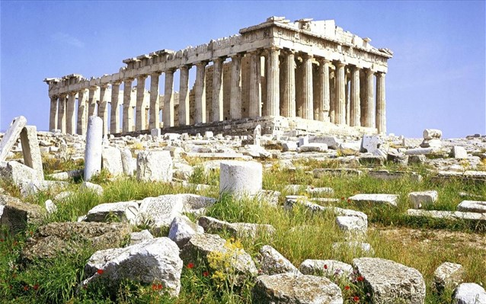
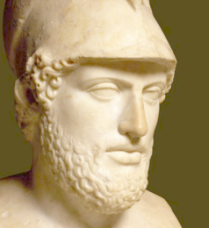
THE GLORY OF ATHENS
DURING PERICLE’S GOLDEN AGE (480-400 BC)

Slide 11
WATER LAW IN ANCIENT ATHENS
ἐπεὶ δὲ πρὸς ὕδωρ οὔτε ποταμοῖς ἐστιν ἀενάοις οὔτε λίμναις τισὶν οὔτ᾽ ἀφθόνοις πηγαῖς ἡ χώρα διαρκής, ἀλλ᾽ οἱ πλεῖστοι φρέασι ποιητοῖς ἐχρῶντο, νόμον ἔγραψεν,….
Since the area is not sufficiently supplied with water, either from continuous flow rivers, or lakes or rich springs, but most people used artificial wells, Solon made a law, …….

Slide 12
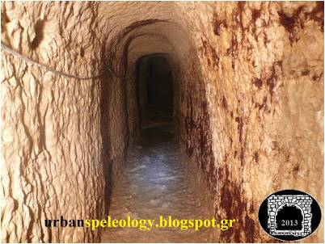
The “Imittos” aqueduct in Athens (4ος cent. BC) National Garden’s irrigation water today

Slide 13
THE DIALECTIC PARADOX OF
HYDRO-GOVERNANCE
WATER
PROBLEMS
- Pollution
- Scarcity
- Floods
HYDRO- GOVERNANCE
“bad”
The example of Middle East

Slide 14
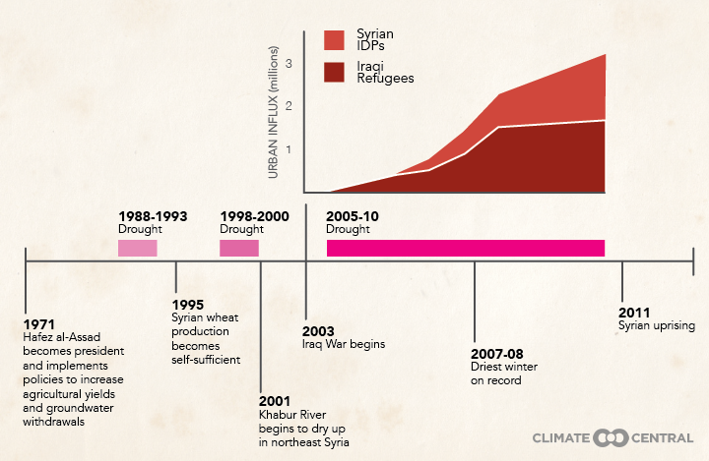
Droughts, water scarcity and policy as risk factors in the Syrian conflict and war (Climate Central, 2015 from Kelly and al., 2015)

Slide 15
THE DIALECTIC PARADOX OF
HYDRO-GOVERNANCE
WATER
PROBLEMS
- Pollution
- Scarcity
- Floods
HYDRO- GOVERNANCE
The example of the EU/WFD

Slide 16
CONFLICTS AND CHALLENGES
NEW CONDITIONS IN THE 2000s: RESPONDING TO SOCIAL AND ENVIRONMENTAL SUSTAINABILITY NEEDS IN EUROPE
(FROM CLASSICAL TECHNICO-ECONOMIC APPROACHES)
Internationalization of water markets have introduced the private sector
Multiplication of power centers and decision-making scales in the water sector
Increasing concern for the environment
Substitute political action with stakeholders participation. Create Social Capital
3 main conflictual issues: 1) full cost recovery, 2) hazardous substances and
3) the implementation timeline
Actors: NGOs, Local Authorities, Consumers, Industry, Agriculture
Governance Conflicts: Local Authorities-River Basin Authorities, zero emission of priority hazardous substances

Slide 17
THE IWRM METHODOLOGY
RESOURCES
  Surface Water
  Groundwater
  Soil
STAKEHOLDERS
Organisations
Companies
NGOs
SECTORS
Drinking
Agriculture
Industry
INTEGRATED WATER RESOURCES MANAGEMENT (IWRM)
IMPACTS
Environment
Economic
Social
INSTITUTIONS
Public
Private
Research
DISCIPLINES
Engineering
Geology
Economy

Slide 18
THE EU WATER FRAMEWORK DIRECTIVE

Slide 19
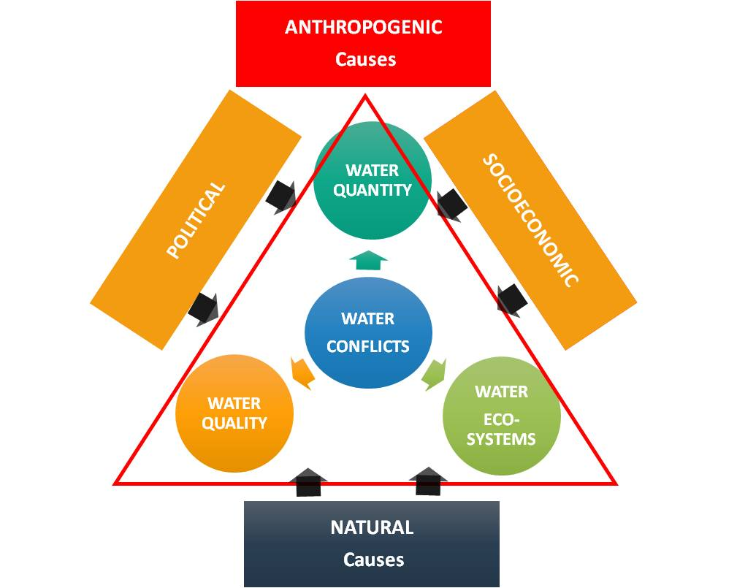
UNDERSTANDING WATER CONFLICTS

Slide 20
DATA CONFLICTS
RELATIONSHIP CONFLICTS
STRUCTURAL CONFLICTS
Negative attitude
Unreliable data
Limited information
Poor communication
Historical
Political
INTEREST CONFLICTS
Economic
Public
VALUE CONFLICTS
Socio-economic values
Religious values
Different interpretation
Different assessment
Misperception
Emotive behavior
Self defied values
Individual
Physical
Geographic
Notes:
© Copyright Showeet.com

Slide 21
From Conflict to Active Collaboration
ADVERSARIAL
REFLEXIVE
INTEGRATIVE
Thinking + & -
Zero-Sum
Win-Lose
Evaluate Positions
Win-Win
Positive Sum
COLLABORATIVE
Team Working
Common Skills
ACTIVE
Implementing Projects
Increase Capacity
Distributive
Cost-Benefit Analysis
Common Interests
Innovation
Dissemination
Notes:
© Copyright Showeet.com

Slide 22
Special Secretariat for Water
Strategic Activities & Initiatives

Slide 23
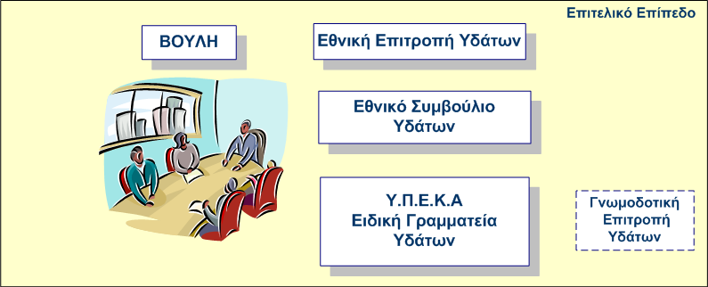
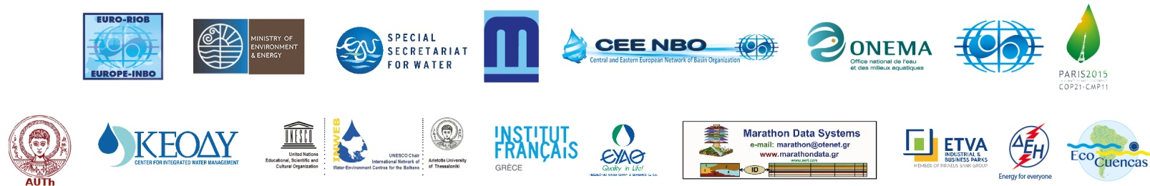
WATER GOVERNANCE AT NATIONAL LEVEL
National Strategic Level
Central Government
Parliament
National Water Council
(Advisory, Civil Society, NGOs)
National Water Commission
(Inter-Ministerial Decision Making)
Special Secretariat for Water (SSW)
Ministry for Environment & Energy
Inter-Ministerial
Advisory
Commission

Slide 24
WATER IN GREECE
HIGH HYDROLOGICALVARIABILITY
14 WATER DISTRICTS
14 WATER MANAGEMENT PLANS
Water Management plans:
2010-2015
First Revision:
Dec. 2017

Slide 25
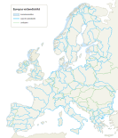
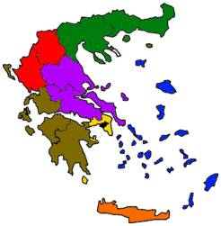
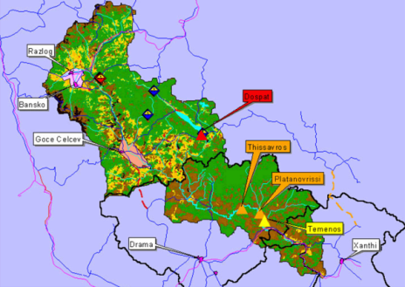
WATER GOVERNANCE AT CENTRAL & REGIONAL/LOCAL LEVEL
International level
EU
National level
ΕΛΚΕΘΕ
”Measure” authorities
about 20
ssw
Water districts
Regional adm. Boards (7)
Water Districts (14)
Regional water administrations
Regional elected boards
Local level
River Basins
Water Stakeholders
Municipalities, authorities, business/public interest groups,
local stakeholders, organizations, landowners, etc.

Slide 26
THE 2019 EU/WFD FITNESS CHECK
Aim | The Fitness Check of the EU Water Legislation is a policy evaluation of its effectiveness, coherence, efficiency, relevance and EU added value. The target is to improve the EU Water legislation, mainly the WFD by making it more responsive to current and future challenges
Effectiveness | The WF and the UWWT Directives have not fully achieved their objectives, i.e. getting the "good" environmental status of water bodies at the River Basin Scale. Substantial progress has been made but their implementation is not fully satisfactory yet. Both Directives very water centric (which is logical) but this fails to address in a coordinated way users of different water sectors and the effective wastewater re-use in a circular economy.
Coherence | There is no conflict between the pieces of legislation themselves but there are gaps, and more is needed to bridge these gaps and having a common approach by all MS. The Water - Energy - Food Nexus – is a useful approach for integrated policy, but it is not clear how to get a win-win result.

Slide 27
Efficiency for Implementing the EU Water Legislation | There are many ways for assessing costs and benefits in both Directives if externalities are to be taken into consideration. For the benefits it is not only about marketing, as the role of ecosystems and their intrinsic value may be very high. The WFD focuses on technical aspects. There are many actors that are involved without technical knowledge and understanding. If these people are not effectively involved, this fails to capture some important aspects of the WFD implementation.
Challenges in Transboundary cooperation | More efforts are necessary for a better collaboration between Member States sharing transbounary waters. There is a high heterogeneity of situations throughout Europe but not enough sharing of good practices and lessons learnt. There is limited success from transboundary cooperation. Alternatively, there is not a ‘model’ of European water governance, and there is no mechanisms to compare approaches to governance from different Member States. Danube and Rhin River Management Committees are good examples, but these existed before the WFD. Finally, there is need to enforce transboundary cooperation beyond the EU-MS. For example, in the Balkans, more than 80% of groundwater are shared in between Serbia, Albania, Romania, Greece, Bulgaria etc. Some of these are not actually MS but they are interested in applying the WFD principles.
EU added value | Water is not the priority of all MS and without the WFD, the results would not have been reached within the same timeframe. The integrated management of river basins and ecosystems is important and can see benefits from this approach.
Watershed drawing from Pearl (2005)

Slide 28
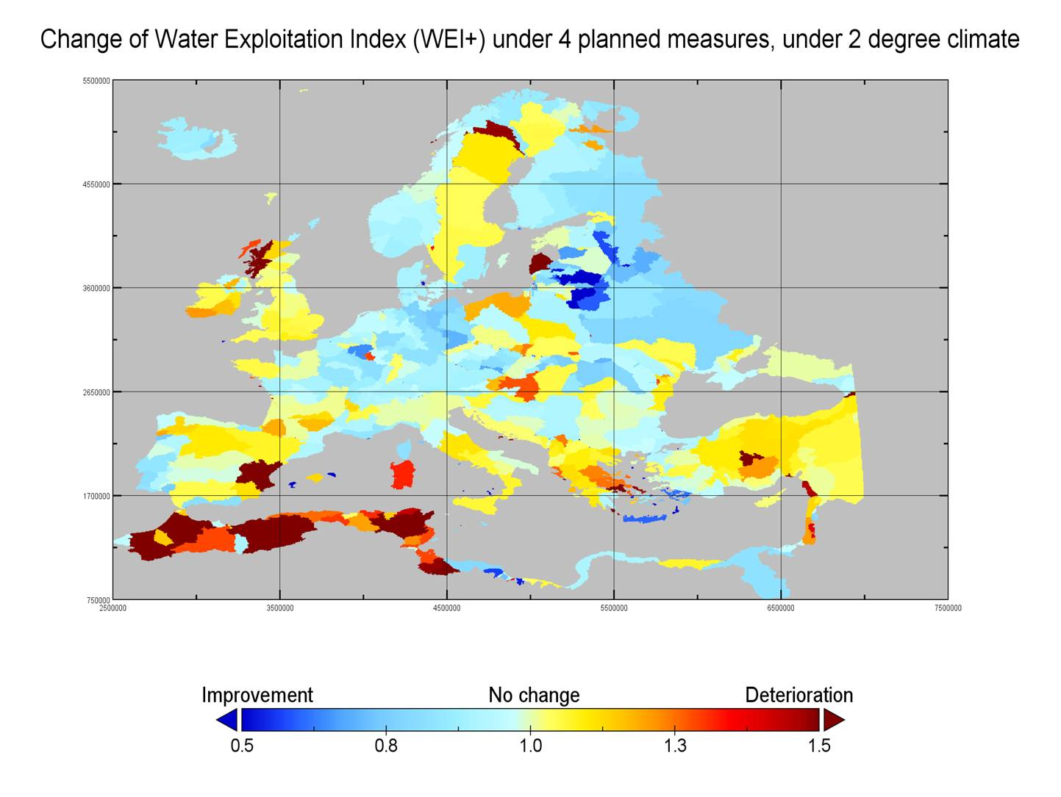

Slide 29
TOWARD AN
UNIFIED-INTEGRATED-DECENTRALISED
HYDRO-GOVERNANCE
NATIONAL LEVEL
  National Water Authority
  Ministries
REGIONAL LEVEL
  Regional Elected Authorities
  State Administration
RIVER BASIN LEVEL
  River Basin Authority
LOCAL LEVEL
  Municipalities
  Water and Sewage Administrations
  Agricultural Associations
  NGOs

Slide 30
CAPACITY BUILDING
JOINT MANAGEMENT/RBO
At Interstate Level
At Interstate Level
HYDRO-DIPLOMACY/COOPERATION
Science
Law/Policy
Socio- economics
Scaling
Decision making
Groundwater
Surface water
Consultation
Participation
Funding
National
Regional
Local
Social Drivers at State Level
Ganoulis & Fried, 2018
Notes:
© Copyright Showeet.com

Slide 31
CONCLUSIONS
1.”Good” Hydro-Governance (GHG) for sustainability
2. Conditions for Change & How to Achieve GHG
3. Water Diplomacy & Conflict Resolution
4. Social Capital and Step-by-Step Approach
5. Lessons Learned: Comparing EU-California HG

Slide 32
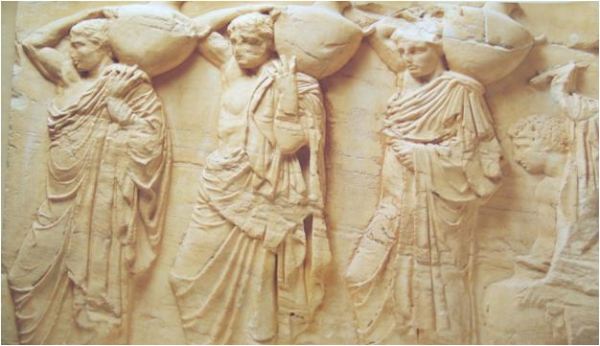
COOPERATION FOR WATER:
A VERY OLD STORY
COLLABORATIVE SCIENCE/KNOWLEDGE FOR GOOD-GOVERNANCE

Slide 33


Slide 34

thank you for your attention!
www.inweb.gr

